Slide 1


ORGANOCITY

Slide 2
Our Team Members:
Amit Kumar Karn
Saurav Shrestha
Kritika Thapa
Yogesh Shrestha
Saugat Adhikari
Ram Babu Shah
Slide: Website Demo
Slide: Website Demo
Slide: 5 to 17
Slide: Website Demo
Slide: 1 to 4 & Website Demo
Slide: Website Demo

Slide 3

Scope
Of
the
Project

Slide 4
Allow the traders to sell their goods locally without impeding on their personal time.
Make purchase of fresh goods possible for locals at all times as well as extend the range of the market.
Increase the sales of traders’ stores resulting in a positive turnover.

Slide 5

Belbin Analysis

Slide 6

Members And Roles:
Amit Kumar Karn:
Saurav Shrestha:
Kritika Thapa:
Yogesh Shrestha:
Ram Babu Shah:
Saugat Adhikari:
Plant, Specialist, Shaper
Co-Ordinator, Specialist, Plant
Team-Worker, Resource Investigator, Completer Finisher
Resource Investigator, Specialist, Implementer
Implementer, Monitor-Evaluator, Specialist
Completer Finisher, Team-Worker, Resource Investigator

Slide 7
Extended Entity Relationship Diagram

Slide 8
Entity Relationship Diagram

Slide 9
Composite Model Diagram

Slide 10
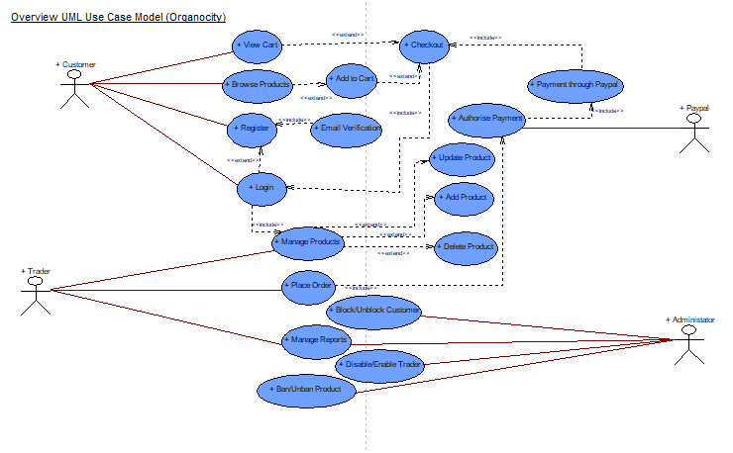
Overview Use Case Diagram

Slide 11
MS - Project

Slide 12
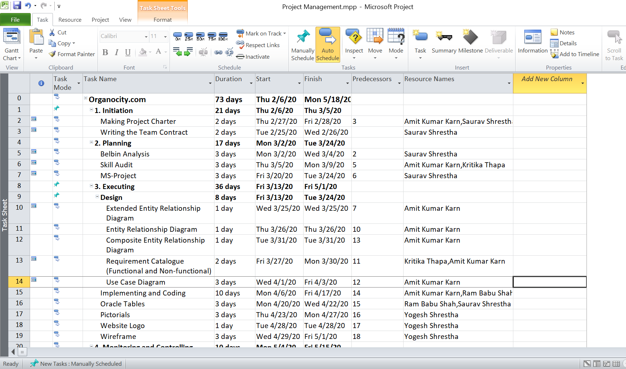
Task Sheet

Slide 13
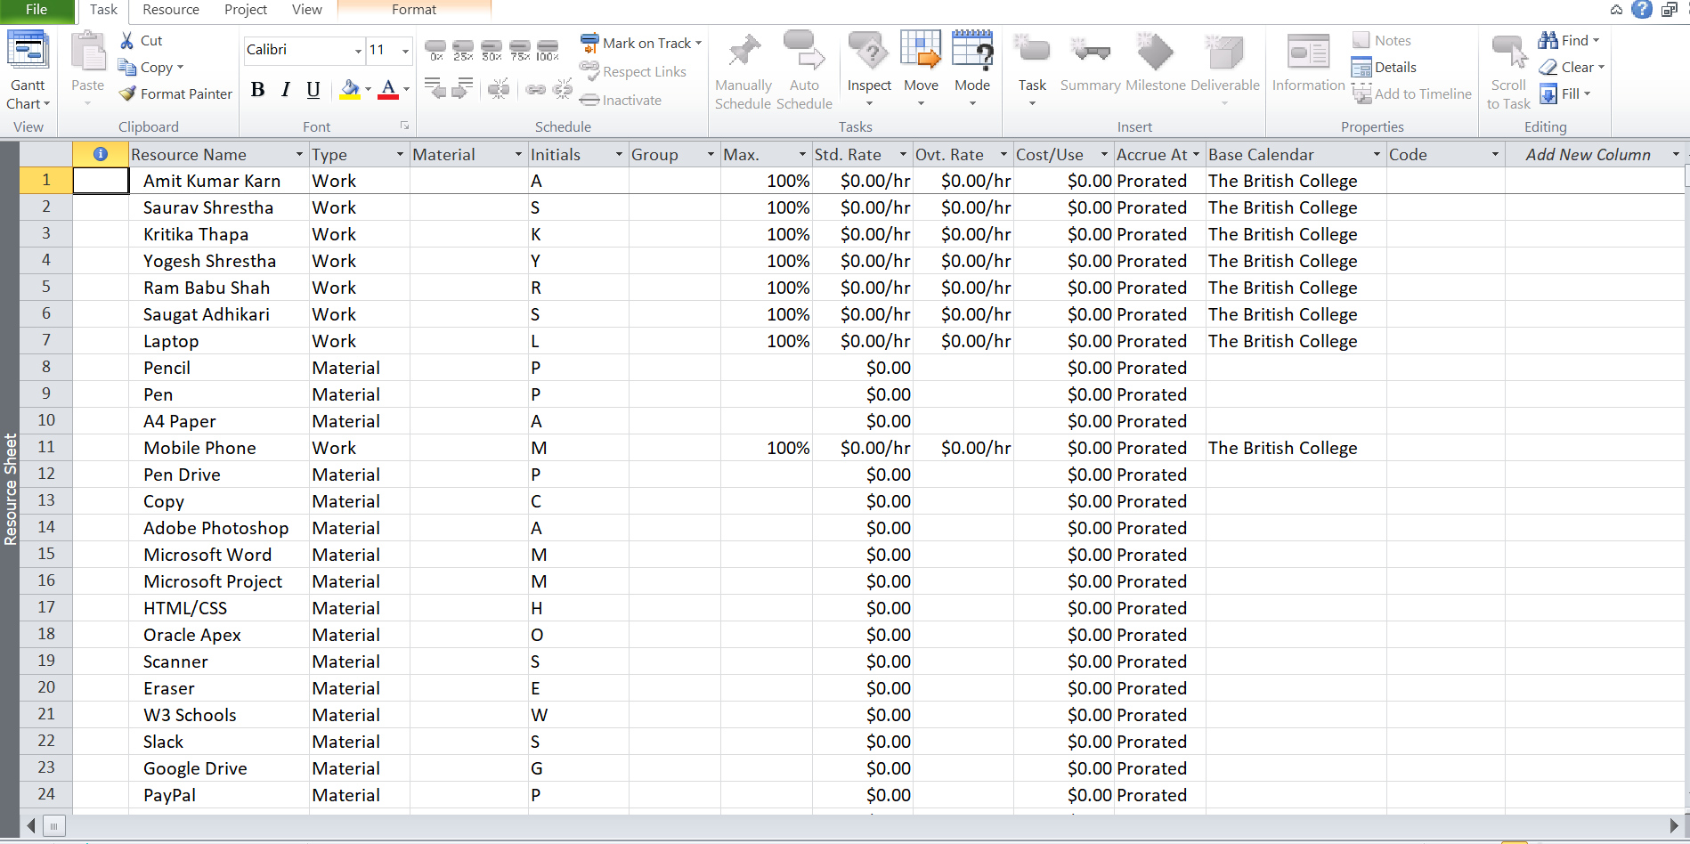
Resource Sheet

Slide 14
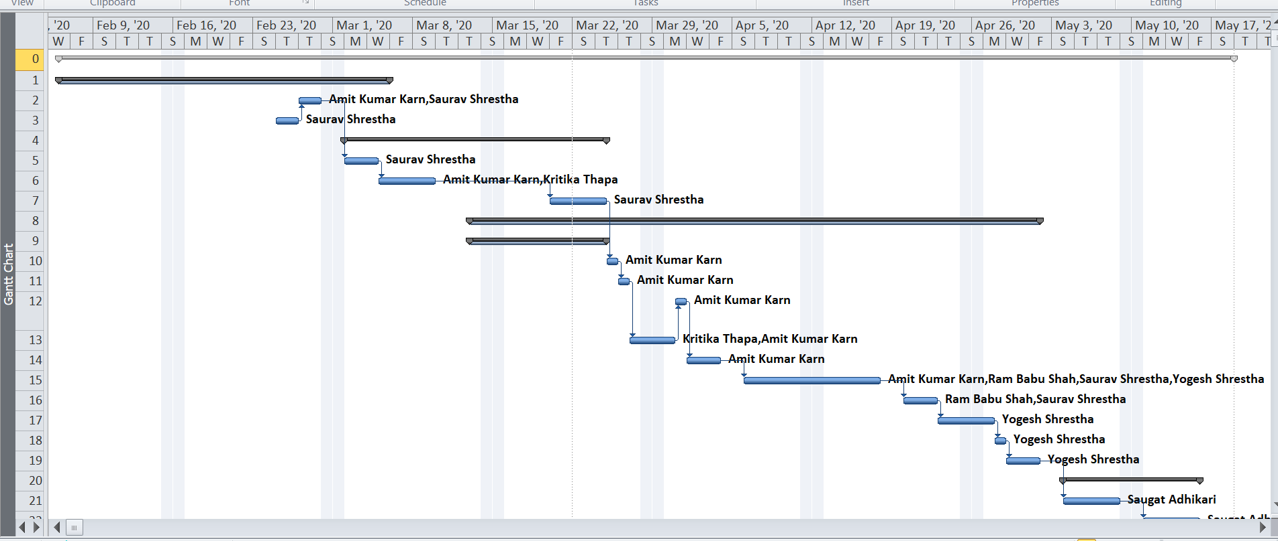
Gantt Chart

Slide 15
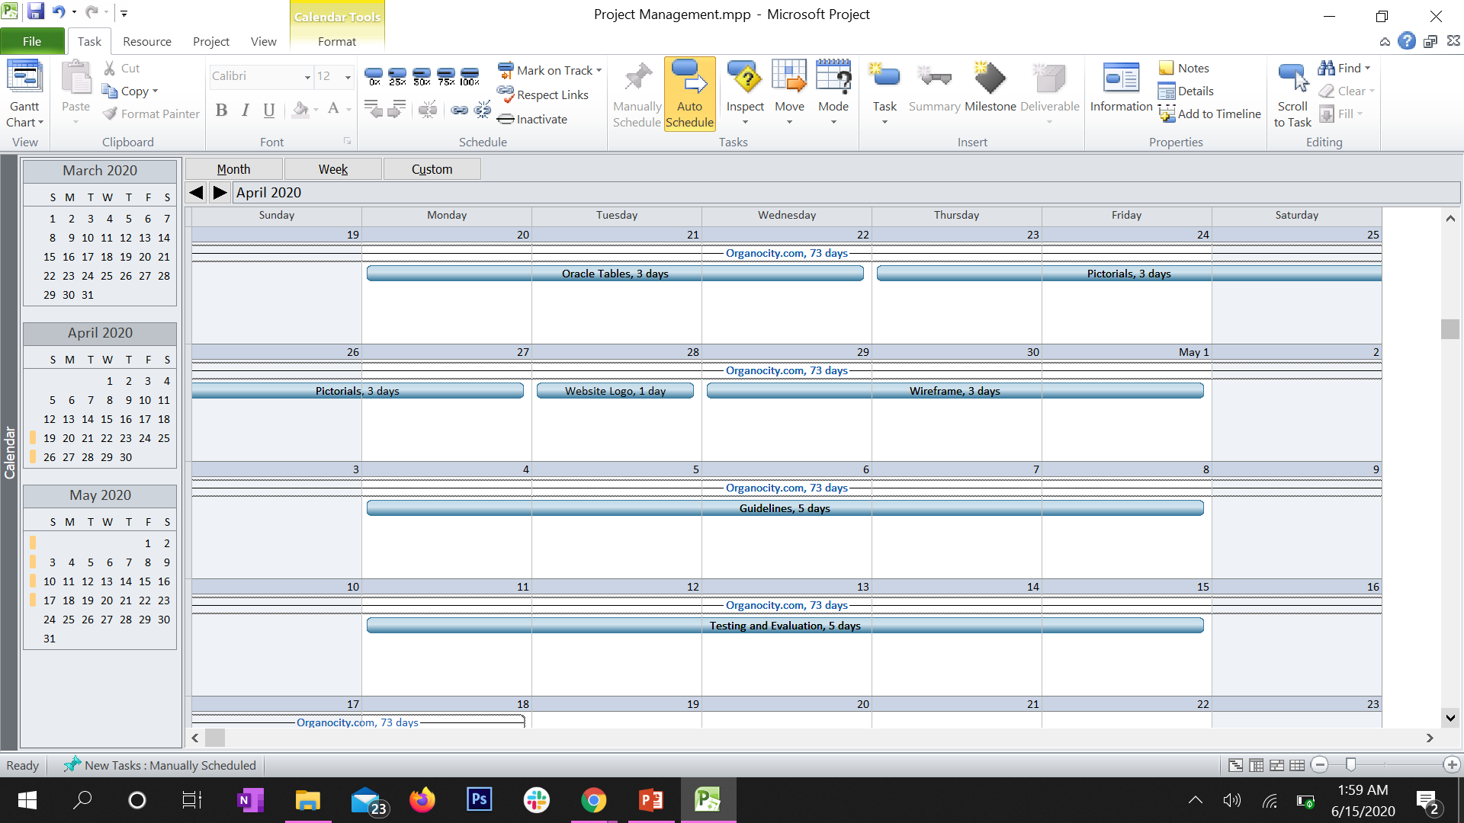
Calendar

Slide 16
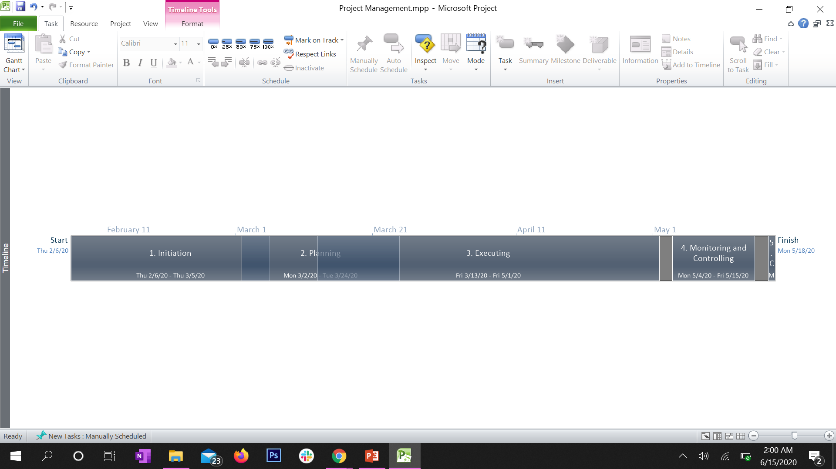
Timeline

Slide 17
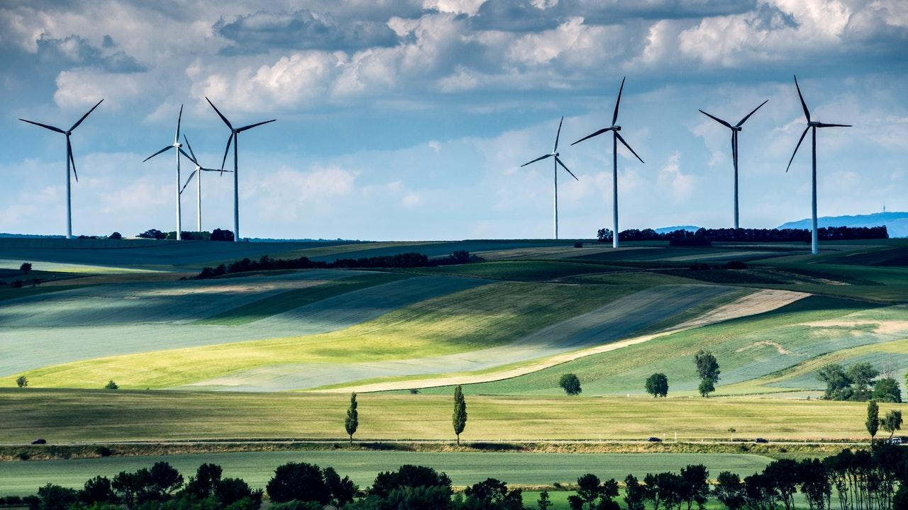
WEBSITE DEMONSTRATION

